Slide 1
An Overview of Self-supervised Methods
Qinwei Xu 2019/05/07
Reference:
Self-supervised Visual Feature Learning with Deep Neural Networks: A Survey arixiv 2019

Slide 2
What is self-supervised learning?
Difference between pure unsupervised learning and self-supervised learning
Pure unsupervised learning does not need any supervision signals
Self-supervised learning needs supervision signals (using automatically generated pseudo labels)
Generalized definition
As long as the supervision signals are not generated by human annotations, the learning paradigm is self-supervised
Significance
Target tasks can greatly benefit from self-supervised pre-training when training data (especially labelled training data) are scarce

Slide 3
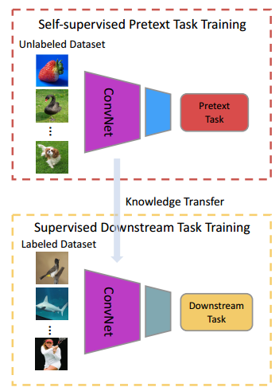
What is self-supervised learning?
General pipeline of self-supervised learning
The purpose is to transfer features trained from self-supervised pretext tasks to supervised downstream / target tasks;
Visual features from only the first several layers are transferred as high-level features contains task-specific signals;
Performance of the target task is used to evaluate the quality of self-supervised learning

Slide 4
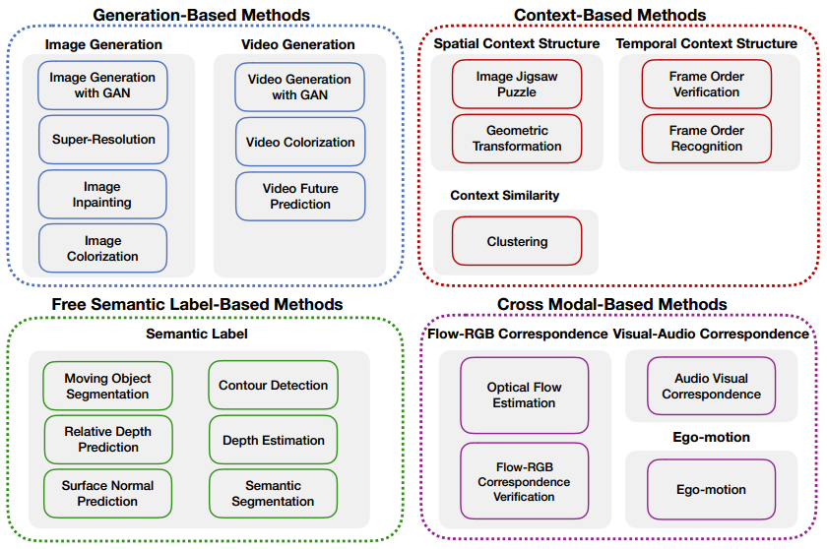
Self-supervised pretext tasks
Notes:
有一些本来不属于自监督的方法也被归为了自监督，比如图像生成、超分辨、视频生成、光流预测等

Slide 5
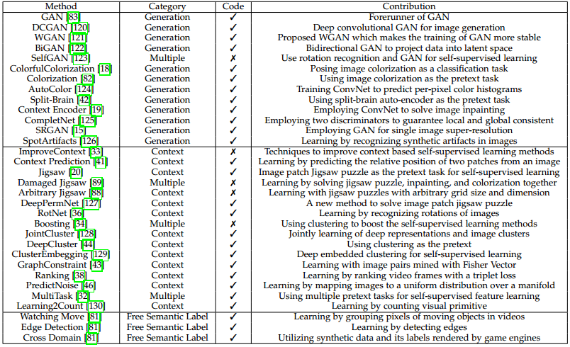
Image feature learning methods

Slide 6
Generation-based image feature learning
Pretext tasks
Image generation with GAN
Image generation with inpainting
Image generation with super resolution
Parameters of the discriminator can be transferred
It needs to capture semantic features to distinguish real or fake images
These tasks are not designed for self-supervised pre-training
The main purpose is image generation / inpainting / super resolution
Only a few works have been done to transfer the features of these tasks
Notes:
Discriminator是否通过捕捉语义特征来进行判别这一点存疑，有可能是通过图片的纹理差异；
只有一篇做inpainting的文章研究了generator参数的迁移

Slide 7
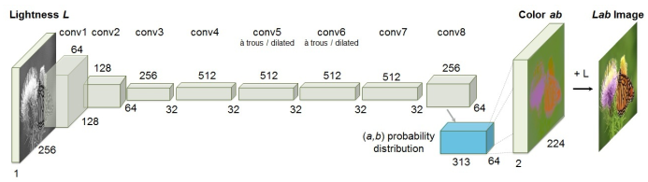
Generation-based image feature learning
Pretext tasks
Image generation with colorization
a FCN structure for colorization [1]
Networks need to recognize objects and to group pixels of the same part together to correctly colorize each pixel
[1] R. Zhang, P. Isola, and A. A. Efros, “Colorful image colorization,” in ECCV, pp. 649–666, Springer, 2016.
Notes:
Colorization是正统的self-supervised方法
可能学到一些物体形状有关的信息
有点类似semantic segmentation

Slide 8
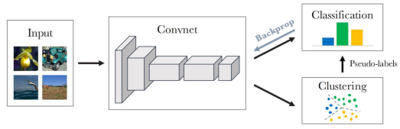
Context-based image feature learning
Learning with context similarity
Architecture of DeepClustering [2]
Iteratively cluster the features
Cluster assignments are used as pseudo labels
Initial features are generated by hand-designed features (HOG, SIFT or Fisher Vector)
[2] M. Caron, P. Bojanowski, A. Joulin, and M. Douze, “Deep clustering for unsupervised learning of visual features,” in ECCV, 2018.

Slide 9
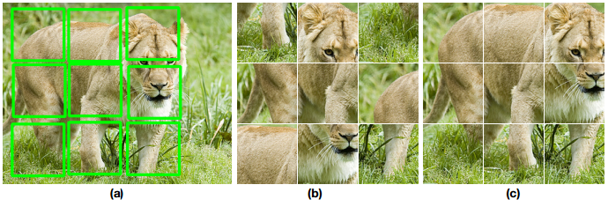
Context-based image feature learning
Learning with spatial context structure
Predict the relative positions of two patches from same image
Predict the correct order of a Jigsaw puzzle
Recognize the rotating angles of the whole images
Jigsaw puzzle [3]
[3] M. Noroozi and P. Favaro, “Unsupervised learning of visual representions by solving jigsaw puzzles,” in ECCV, 2016

Slide 10
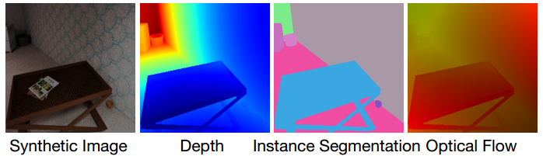
Free Semantic Label-based image feature learning
Learning with Labels Generated by Game Engines
Given models of various objects and layouts of environments, game engines can render realistic images with accurate pixel-level labels
The domain gap between synthetic images and real-world images needs to be addressed when applied to real-world images

Slide 11
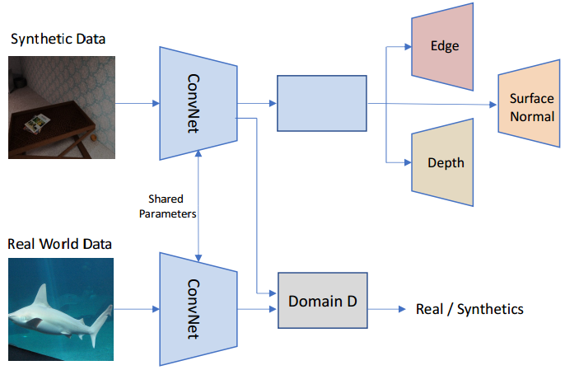
Free Semantic Label-based image feature learning
Learning with Labels Generated by Game Engines
utilizing synthetic and real-world images for self-supervised feature learning
[4] Z. Ren and Y. J. Lee, “Cross-domain self-supervised multi-task feature learning using synthetic imagery,” in CVPR, 2018

Slide 12
Free Semantic Label-based image feature learning
Learning with Labels Generated by Hard-code programs
Employing hard-code programs on images to obtain labels
Distill knowledge from hard-code detectors, such as foreground object detection, edge detection, relative depth prediction
Drawback: the semantic labels generated by hard-code detector usually are very noisy which need to specifically cope with

Slide 13
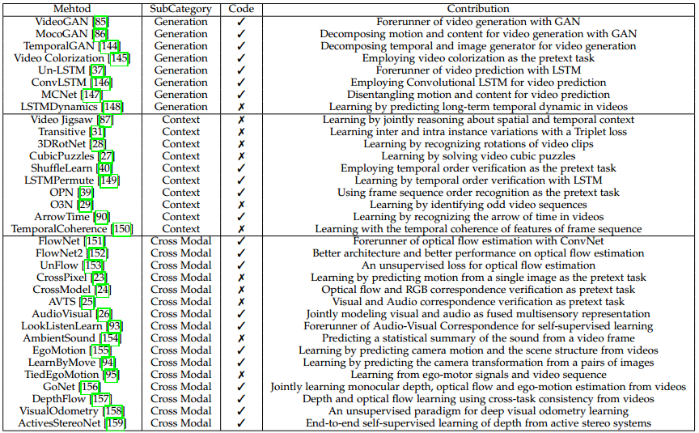
Video feature learning

Slide 14
Free Semantic Label-based image feature learning
Learning from video generation
Parameters of discriminator can be transferred
Learning from video colorization
The color coherence between consecutive frames within a short time is a strong supervision signal
Given the reference RGB frame and a gray-scale image, colorize the gray-scale image
Another perspective is directly transform a grayscale video clip to a colorful video clip

Slide 15
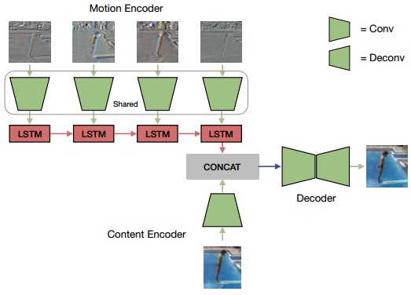
Free Semantic Label-based image feature learning
Learning from video prediction
Predicting future frame sequences based on a limited number of frames
No work has been done to study the generalization ability of features learned by video prediction
[5] R. Villegas, J. Yang, S. Hong, X. Lin, and H. Lee, “Decomposing motion and content for natural video sequence prediction,” in ICLR, 2017.

Slide 16
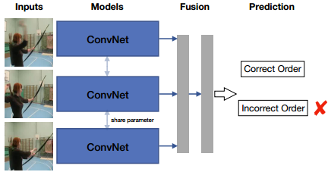
Temporal Context-based Learning
Temporal order verification: correct or incorrect temporal order
Temporal order recognition: recognize the temporal order
Shuffle and Learn [6]
Frames are sampled according to the magnitude of optical flow
Drawback: computation of optical flow is expensive and slow
[6] I. Misra, C. L. Zitnick, and M. Hebert, “Shuffle and learn: unsupervised learning using temporal order verification,” in ECCV, pp. 527–544, Springer, 2016

Slide 17
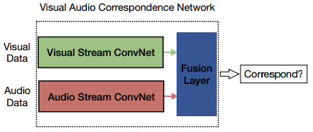
Cross Modal-based Learning
Learning from RGB-Flow Correspondence
Optical flow estimation (e.g., FlowNets)
RGB and optical flow correspondence verification
Learning from Visual-Audio Correspondence
Ego-motion: the correspondence between visual signal and motor signal
[7] R. Arandjelovic and A. Zisserman, “Look, listen and learn,” in ICCV, pp. 609–617, IEEE, 2017
Notes:
Ego-motion: 画面与相机的运动

Slide 18
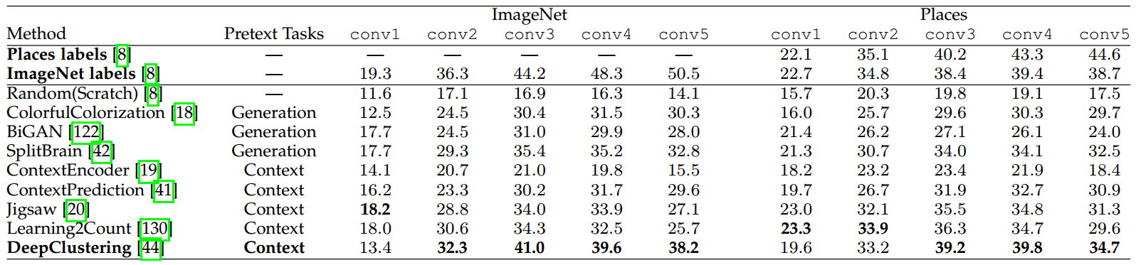
Comparison
Linear classification on ImageNet and Places datasets using activations from the convolutional layers of an AlexNet as features
conv3 & conv4 features preform better !
Shallow layers (conv1 & conv2) capture general low-level features
Deep layers (conv5) capture pretext task-related features
Notes:
Ego-motion: 画面与相机的运动

Slide 19
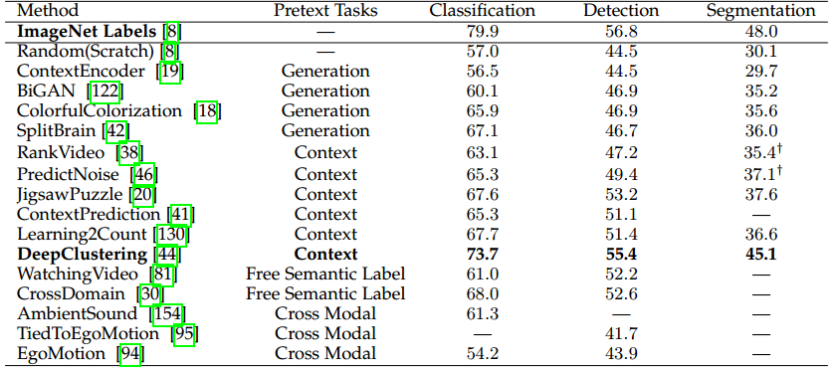
Comparison
Self-supervised image feature learning
Comparable to supervised pre-training, especially for object detection and semantic segmentation

Slide 20
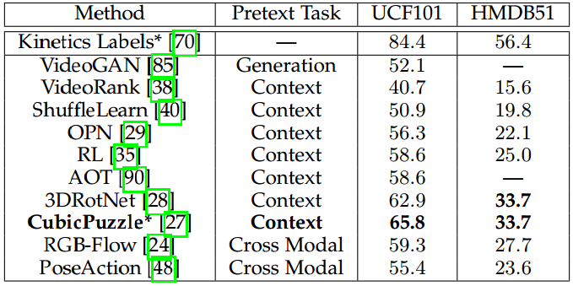
Comparison
Self-supervised video feature learning
Much lower than supervised pre-training, probably due to easy overfitting of 3DConvNets and the complexity of video feature learning
Notes:
因为视频特征多了一个时间维度

Slide 21
Future directions
Learning from synthetic data: bridge the domain gap by GAN
Learning web data: handle the noise in web data and their associated metadata
Learning spatialtemporal features from videos: more effective pretext tasks
Learning with data from different sensors: correspondence of data captured by different devices
Learning with multiple pretext tasks: using different supervision signals

